Slide 1
Clothes Dataset
Image Classification Data from Carousell
872283 Fusaro Mattia

Slide 2
Table of contents
01 /
02 /
03 /
04 /
05 /
The Importance of Image Recognition in Fashion
Why CNNs
Experiments and Model Testing
Challenges and Solutions
Conclusions and Future

Slide 3
01
The Importance of Image Recognition in Fashion
872283 Fusaro Mattia

Slide 4

Data is the New Gold
Data is one of the most valuable resources. ( I know that from my personal experience )
It helps make smarter, evidence-based decisions, Data turns information into action.
This project explores unstructured data through image classification, aiming to understand and address key challenges in the fashion domain.

Slide 5

Image Classification for Fashion E-Commerce
Dataset of fashion images from Carousell, an online marketplace.
15 clothing categories including jeans, blazers, skirts, and jackets.
With variety like different colors, textures, styles, and lighting.
The goal is to train a neural network to classify clothing types automatically.

Slide 6
02
Why CNNs
872283 Fusaro Mattia

Slide 7
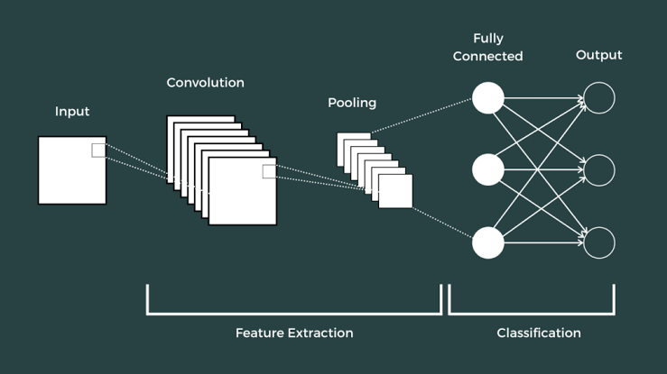
CNNs
Designed to handle high-dimensional image input efficiently.
Use convolutional layers to detect local patterns.
Apply pooling layers to reduce dimensionality and retain important features.
Low-level to high-level features.
Require fewer parameters than fully connected networks thanks to weight sharing.

Slide 8
03
Experiments and Model Testing
872283 Fusaro Mattia

Slide 9
Trained multiple CNN architectures based on AlexNet:
Exploring Architectures & Training Strategies
Original AlexNet
Original AlexNet-style with 3 Conv2D layers per block
Modified sequential models with BatchNormalization after each Conv2D
Variations with MaxPooling2D(2,2) and strided convolutions replacing pooling
Tested different input image sizes
Used ImageDataGenerator with advanced augmentation (flip, rotate, zoom, shear, shift)
Compiled all with Adam optimizer (lr=0.001), categorical crossentropy loss
Applied callbacks: EarlyStopping (patience=5), ReduceLROnPlateau (factor=0.3, patience=3)
Trained for up to 40 epochs with validation split (20%)

Slide 10
04
Challenges and Solutions
872283 Fusaro Mattia

Slide 11
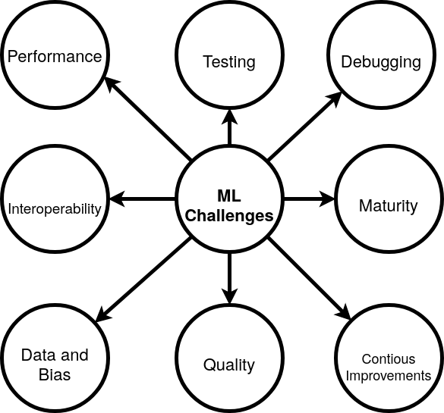
Managing Complexity
Long training time on complex models
Versioning issues
Underfitting in early models
Too many variables (hyperparameters)
Overwhelming settings to tune

Slide 12
Results
 | Key Points | Params | Kernel | Pooling Strategy | Training Accuracy | Prediction Accuracy
AlexNet | Classic and Heavier | 60 M | 11x11 to 3x3 | Max Pooling 3x3 | 6 % | 6 %
AlexNet 3Conv Block | Expensive and Deep | 9 M | 5x5 | Max Pooling 2x2 | 68 % | 58 %
Sequential 5 Block | Efficient and Reliable | 2 M | 3x3 | Max Pooling 2x2 | 67 % | 57 %
Sequential 6 Block | Aggressive and Complex | 20 M | 5x5 | Max Pooling 2x2 and end with Max Pooling 1x1 | 85 % | 60 %
Sequential 5 Block with strides | Compromise | 14 M | 3x3 | Max Pooling 2×2 and Strided Convolutions | 63 % | 48 %

Slide 13
05
Conclusions and Future
872283 Fusaro Mattia

Slide 14
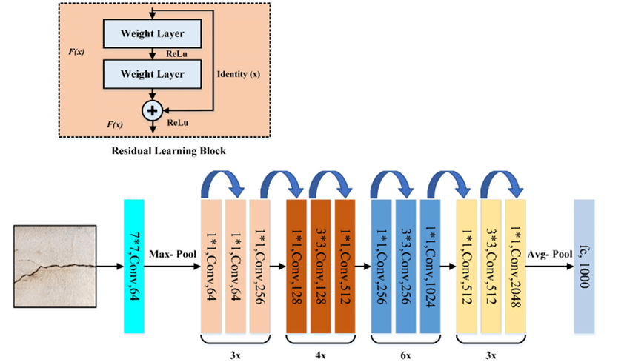
Conclusions and Future
Limited dataset and suboptimal data augmentation
Restricted computational resources
Potential improvements include:
Increasing the number of training epochs
Applying more effective data augmentation techniques
Enhancing batch normalization strategies
Experimenting with different learning rates
A well-established solution exists: ResNet

Slide 15
Thanks!
Thank you for your attention, wishing you a pleasant day.
872283 Fusaro Mattia

